Slide 1
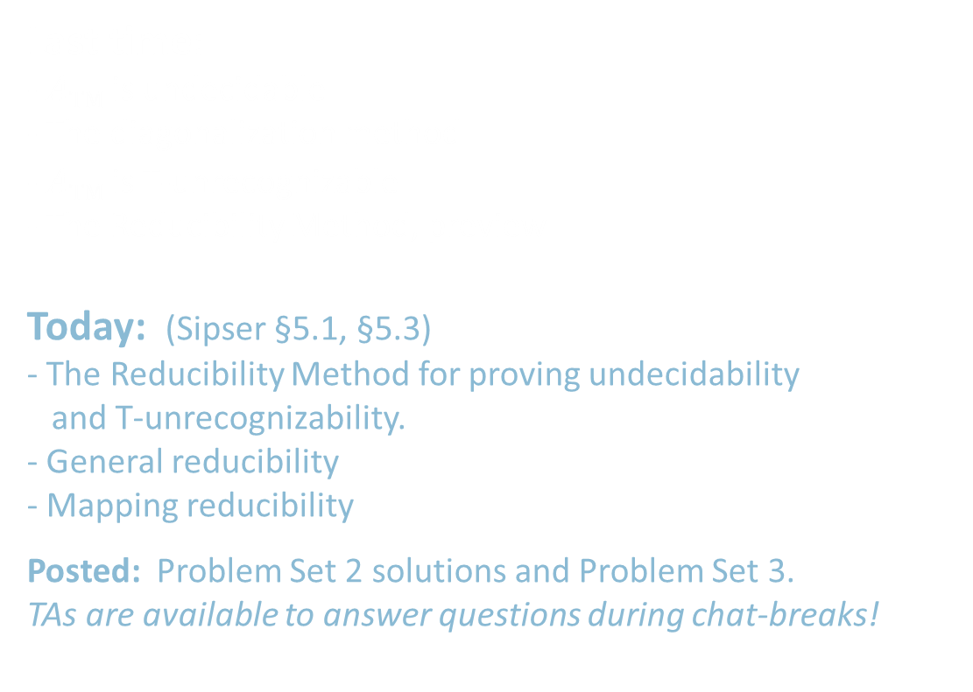
18.404/6.840 Lecture 9
Last time: - $A\text{TM}$ is undecidable
- The diagonalization method
- $\overline{A\text{TM}}$ is T-unrecognizable
- The Reducibility Method, preview
Today: (Sipser §5.1, §5.3) - The Reducibility Method for proving undecidability and T-unrecognizability.
- General reducibility
- Mapping reducibility
Posted: Problem Set 2 solutions and Problem Set 3.
TAs are available to answer questions during chat-breaks!

Slide 2

The Reducibility Method
$FALLOFF\text{TM}$ $=\left\{〈M,w〉\right| M$attempts to move its head to the left of the leftmost cell on input $w\}$

Slide 3

The Reducibility Method
If we know that some problem (say $A\text{TM}$) is undecidable, we can use that to show other problems are undecidable.
Defn: $HALT\text{TM}$ $=\left\{〈M,w〉\right| M$halts on input $w\}$
Theorem: $HALT\text{TM}$ is undecidable
Proof by contradiction, showing that $A\text{TM}$ is reducible to $HALT\text{TM}$:
Assume that $HALT\text{TM}$ is decidable and show that $A\text{TM}$ is decidable (false!).
Let TM $R$ decide $HALT\text{TM}$.
Construct TM $S$ deciding $A\text{TM}$.
$S=$ “On input $〈M,w〉$
1. Use $R$ to test if $M$ on $w$ halts. If not, reject.
2. Simulate $M$ on $w$ until it halts (as guaranteed by $R$).
3. If $M$ has accepted then accept. If $M$ has rejected then reject.
TM $S$ decides $A\text{TM}$, a contradiction. Therefore $HALT\text{TM}$ is undecidable.

Slide 4



$E\text{TM}$ is undecidable
Let $E\text{TM}$ $=\{〈M〉| M$ is a TM and $L\left(M\right)=∅ \}$
Theorem: $E\text{TM}$ is undecidable
Proof by contradiction. Show that $A\text{TM}$ is reducible to $E\text{TM}$.
Assume that $E\text{TM}$ is decidable and show that $A\text{TM}$ is decidable (false!).
Let TM $R$ decide $E\text{TM}$.
Construct TM $S$ deciding $A\text{TM}$.
$S=$ “On input $〈M,w〉$
1. Transform $M$ to new TM $M_{w}=$ “On input $x$
1. If $x≠w$, reject.
2. else run $M$ on $w$
3. Accept if $M$ accepts.”
2. Use $R$ to test whether $L(M_{w}) =∅$
3. If YES [so $M$ rejects $w$] then reject. If NO [so $M$ accepts $w$] then accept.
$M_{w}$ works like $M$ except that it always rejects strings $x$ where $x≠w$.
So $L\left(M_{w}\right)=\left\{\begin{aligned}\left\{w\right\} \text{if} M accepts w \\ ∅ \text{if} M rejects w\end{aligned}\right.$

Slide 5








Mapping Reducibility
Defn: Function $f:Σ^{∗}→Σ^{∗}$ is computable if there is a TM $F$ where$F$ on input $w$ halts with $f(w)$ on its tape, for all strings $w$.
Defn: $A$ is mapping-reducible to $B$ ($A≤_{m}B$) if there is a computable function $f$ where $w∈A$ iff $f\left(w\right)∈B$.
$$w$$
$$f\left(w\right)$$
$$A$$
$$B$$
$$f$$
Example: $A\text{TM}$ $≤_{m}\overline{E\text{TM}}$
The computable reduction function $f$ is $f(〈M,w〉$) = $〈M_{w}〉$
Because $〈M,w〉∈A\text{TM}$ iff $〈M_{w}〉∈\overline{E\text{TM}}$
( $M$ accepts $w$ iff $L\left(〈M_{w}〉\right)≠∅$ )
Recall TM $M_{w}=$ “On input $x$
1. If $x≠w$, reject.
2. else run $M$ on $w$
3. Accept if $M$ accepts.”

Slide 6




Mapping Reductions - properties
Theorem: If $A≤_{m}B$ and $B$ is decidable then so is $A$
Proof: Say TM $R$ decides $B$.
Construct TM $S$ deciding $A$:
$S=$ “On input $w$
1. Compute $f(w)$
2. Run $R$ on $f(w)$ to test if $f\left(w\right)∈B$
3. If $R$ halts then output same result.”
Corollary: If $A≤_{m}B$ and $A$ is undecidable then so is $B$
Theorem: If $A≤_{m}B$ and $B$ is T-recognizable then so is $A$ Proof: Same as above.
Corollary: If $A≤_{m}B$ and $A$ is T-unrecognizable then so is $B$
$$A$$
$$f$$
$$B$$

Slide 7






Mapping vs General Reducibility
Mapping Reducibility of $A$ to $B$: Translate $A$-questions to $B$-questions.
- A special type of reducibility
- Useful to prove T-unrecognizability
(General) Reducibility of $A$ to $B$: Use $B$ solver to solve $A$.
- May be conceptually simpler
- Useful to prove undecidability
Noteworthy difference:
- $A$ is reducible to $\overline{A}$
- $A$ may not be mapping reducible to $\overline{A}$. For example $\overline{A\text{TM}}≰_{m}$ $A\text{TM}$
$$A$$
$$f$$
$$B$$
$A$ solver
$B$ solver

Slide 8
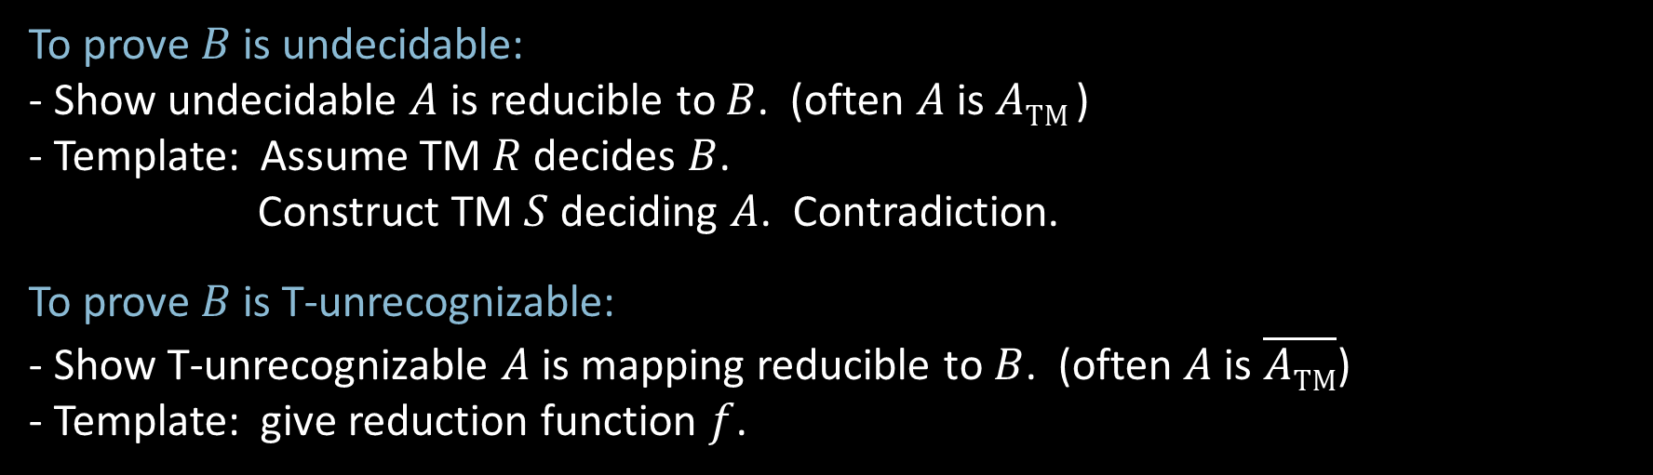
Reducibility – Templates
To prove $B$ is undecidable:
- Show undecidable $A$ is reducible to $B$. (often $A$ is $A\text{TM}$)
- Template: Assume TM $R$ decides $B$.
Construct TM $S$ deciding $A$. Contradiction.
To prove $B$ is T-unrecognizable:
- Show T-unrecognizable $A$ is mapping reducible to $B$. (often $A$ is $\overline{A\text{TM}}$)
- Template: give reduction function $f$.

Slide 9






$E\text{TM}$ is T-unrecognizable
Recall $E\text{TM}$ $=\{〈M〉| M$ is a TM and $L\left(M\right)=∅ \}$
Theorem: $E\text{TM}$ is T-unrecognizable
Proof: Show $\overline{A\text{TM}} ≤_{m}E\text{TM}$
Reduction function: $f\left(〈M,w〉\right)=〈M_{w}〉$
Explanation: $〈M,w〉∈\overline{A\text{TM}}$ iff $〈M_{w}〉∈E\text{TM}$
$M$ rejects $w$ iff $L\left(〈M_{w}〉\right)=∅$
Recall TM $M_{w}=$ “On input $x$
1. If $x≠w$, reject.
2. else run $M$ on $w$
3. Accept if $M$ accepts.”
$$\overline{A\text{TM}}$$
$$f$$
$$E\text{TM}$$

Slide 10



$EQ\text{TM}$ and $\overline{EQ\text{TM}}$ are T-unrecognizable
$EQ\text{TM}=\left\{〈M_{1}, M_{2}〉\right|{ M}_{1}$ and $M_{2}$ are TMs and $L\left(M_{1}\right)=L(M_{2}) \}$
Theorem: Both $EQ\text{TM}$ and $\overline{EQ\text{TM}}$ are T-unrecognizable
Proof: (1) $\overline{A\text{TM}}$ $≤_{m}$ $EQ\text{TM}$
(2) $\overline{A\text{TM}}$ $≤_{m}$ $\overline{EQ\text{TM}}$
For any $w$ let $T_{w}=$“On input $x$
1. Ignore $x$.
2. Simulate $M$ on $w$.”
Here we give $f$which maps $\overline{A\text{TM}}$ problems (of the form $〈M,w〉$) to $EQ\text{TM}$ problems (of the form $〈T_{1},T_{2}〉$).
$f\left(〈M,w〉\right)=〈T_{w}, T_{\text{reject}}〉$ $T_{\text{reject}}$ is a TM that always rejects.
(2) Similarly $f\left(〈M,w〉\right)=〈T_{w}, T_{\text{accept} }〉$ $T_{\text{accept} }$ always accepts.
$T_{w}$ acts on all inputs the way $M$ acts on $w$.

Slide 11

Quick review of today
Introduced The Reducibility Method to prove undecidability and T-unrecognizability.
Defined mapping reducibility as a type of reducibility.
$E\text{TM}$ is undecidable.
$E\text{TM}$ is T-unrecognizable.
$EQ\text{TM}$ and $\overline{EQ\text{TM}}$ are T-unrecognizable.

